Slide 1
Operating system and system programming (25CS2104E)
Linux System Information and Resource Monitoring Tool
Review
Under the Esteemed Guidance of
Raghupathi M
CSE Department
Team Members:
J Pragathi 2520090216
N Charishma 2520090214
J Rakshitha 2520090212

Slide 2
Contents
Abstract
Introduction
Hardware and Software requirements
System Architecture
Conclusion

Slide 3
Abstract
Linux-based tool for monitoring system information and resource usage.
Displays CPU, memory, processes, storage, and file-system information.
Provides information through a command-line interface (CLI).
Uses C programming, Linux system calls, and POSIX APIs.
Demonstrates OS concepts such as process management, IPC, signals, virtual memory, file I/O, threads, and synchronization.
Uses pipes/FIFOs, mutexes, and semaphores for communication and synchronization.
Follows a modular design, allowing different monitoring functions to work independently.
Provides a practical way to observe system activity and analyze resource performance.
Helps gain hands-on understanding of Linux Operating Systems and Systems Programming.

Slide 4
Introduction
Linux systems continuously manage resources such as CPU, memory, processes, storage, and file systems.
Monitoring these resources helps in understanding system performance and activity.
Basic Linux commands may not provide a simple and organized view of all system resources.
Our project develops a Linux System Information and Resource Monitoring Tool.
The tool provides system and resource information through a command-line interface.
It uses C programming, Linux system calls, and POSIX APIs.
The project demonstrates important concepts such as process management, memory management, file I/O, IPC, threads, and synchronization.
The tool provides a practical way to observe and analyze system resources in a Linux environment.

Slide 5
Hardware and Software requirements
Hardware Requirements | Software Requirements
Processor: Intel/AMD processor | Operating System: Linux / Ubuntu
RAM: Minimum 4 GB | Programming Language: C / C++
Storage: At least 10 GB free space | Compiler: GCC
System: Laptop/Desktop computer | APIs: POSIX APIs
Input/Output: Keyboard, monitor, and standard I/O devices | Build Tool: Makefile
- | Version Control: Git / GitHub
- | Development Environment: Linux/Ubuntu terminal

Slide 6
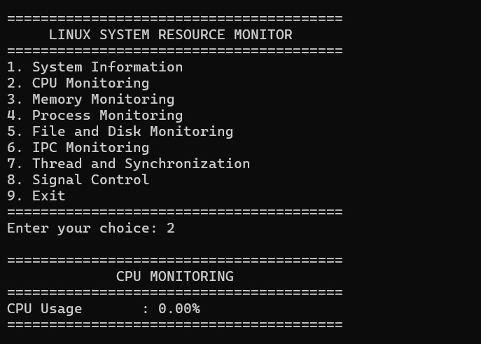
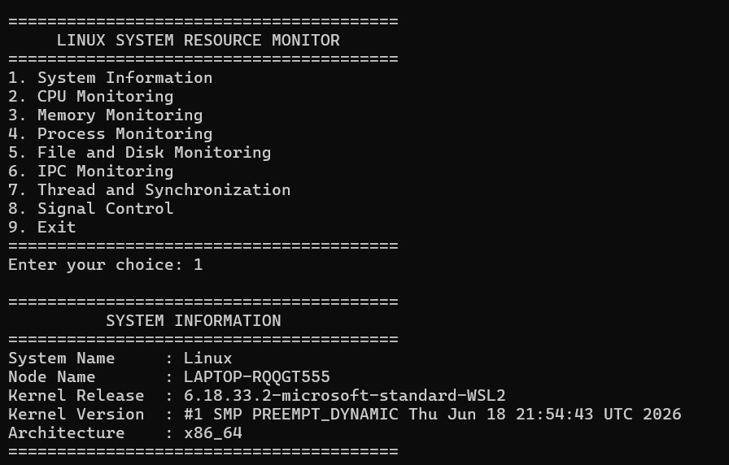
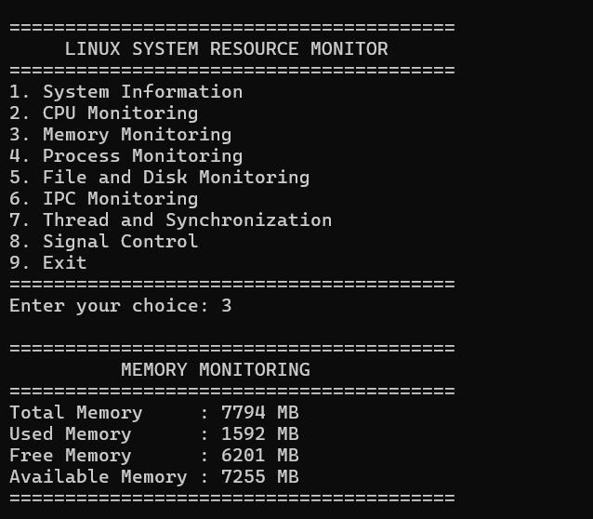
Implementation

Slide 7
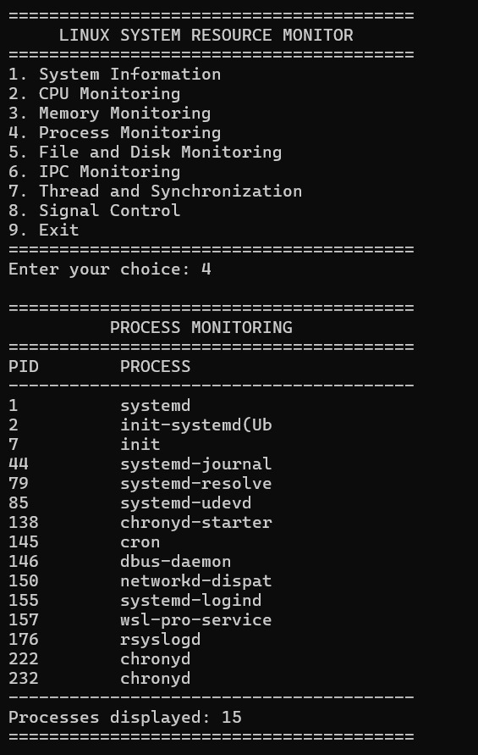
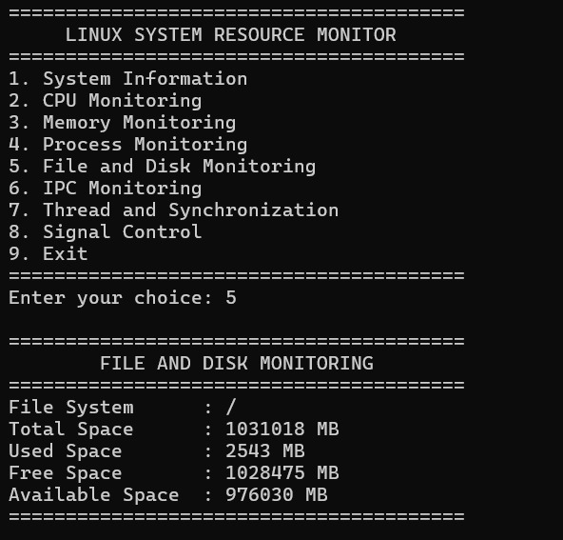
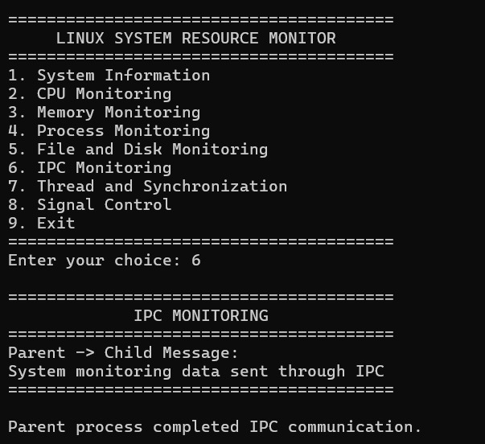

Slide 8
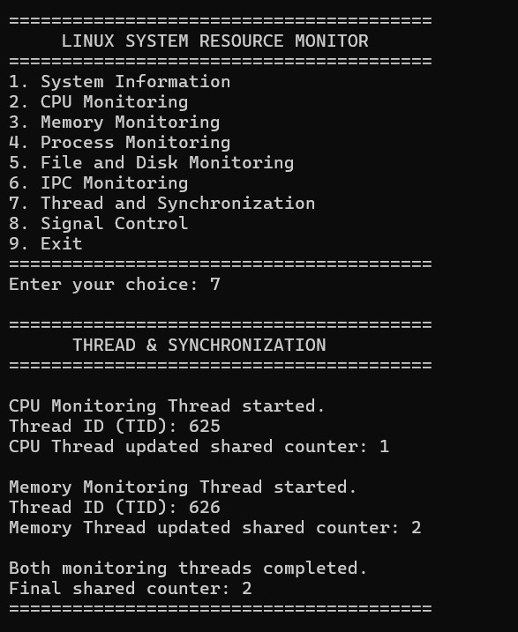
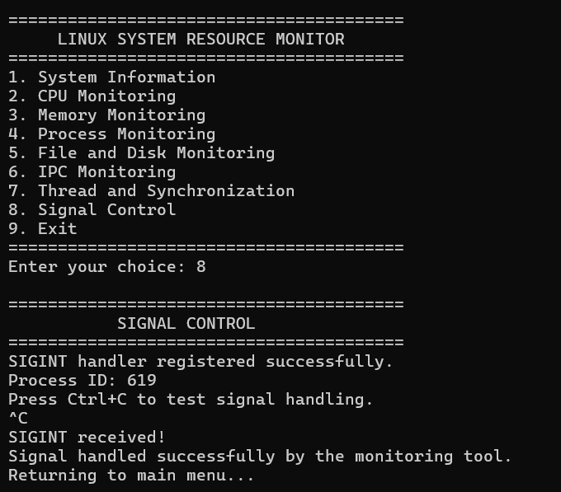
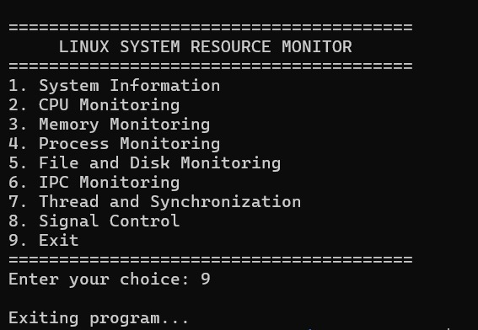

Slide 9
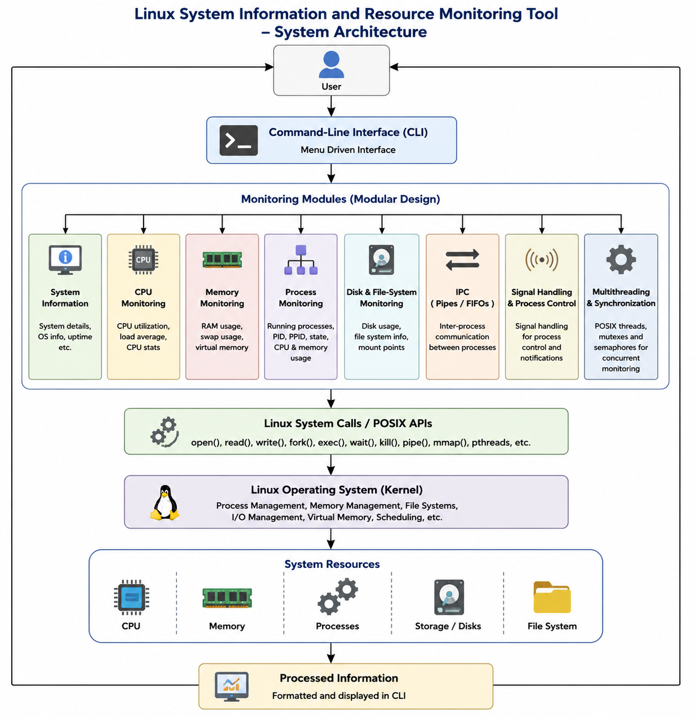
System Architecture

Slide 10
Conclusion
Developed a Linux-based command-line tool for system information and resource monitoring.
Provides information about CPU, memory, processes, storage, and file systems.
Demonstrates important Operating Systems and Systems Programming concepts.
Uses Linux system calls and POSIX APIs for system-level operations.
Implements concepts such as IPC, signals, multithreading, mutexes, and semaphores.
Provides practical experience in C programming and Linux environment.
The project helps in understanding system resources and monitoring system activity efficiently.

Slide 11
Thank you

